Slide 1

01
Digital Tools for Smart Farming
www.smart4food.eu

Slide 2
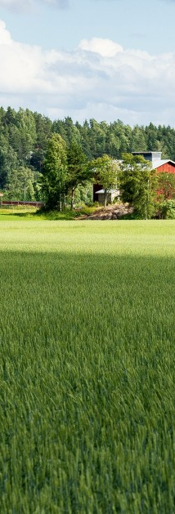
Module Information.
Module number: 01
Module title: Digital Tools for Smart Farming
Estimated completion time for learners: 60–90 minutes
Learning Objective
Learners will be able to understand the value of digital tools in small-scale farming and use selected mobile applications, online platforms, and basic ICT tools to improve daily agricultural activities, decision-making, and data management, while ensuring safe and responsible use of digital technologies.

Slide 3

Agenda
Unit 1: Digital agriculture & smart farming tools
Unit 2: Digital record‑keeping for farm management
Unit 3: Remote sensing & geospatial analysis (NDVI)
Unit 4: IoT sensors & smart irrigation
Unit 5: Artificial intelligence & data analytics
Unit 6: Data ethics, cybersecurity & sustainability
Notes:
Trainer note: Use this slide to set expectations and pacing for Units 1–6 (60–90 minutes).

Slide 4
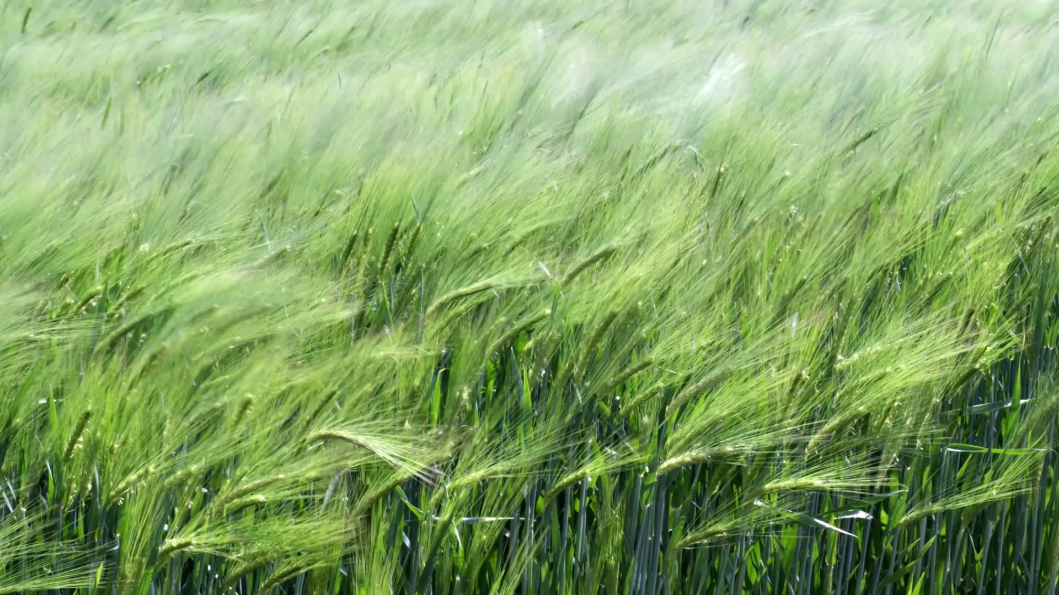
Unit 1: Introduction to Digital Agriculture & Smart Farming Tools
In this unit, learners explore how digitalisation supports small‑scale farming and identify the main categories of smart farming tools.
Notes:
Introduce smart farming and the idea that accessible digital tools can support smallholders. Keep focus on practical use.

Slide 5
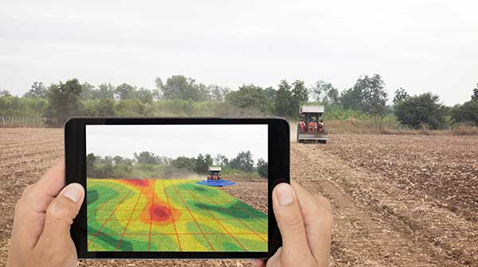
Overview of common smart farming tool types
This Photo by Unknown Author is licensed under CC BY
IoT sensors (soil moisture, temperature, livestock health)
Big data & AI (weather trends, market prices, pest outbreaks)
Remote sensing (satellite/drone imagery)
Blockchain traceability
Robotics/automation
AR/VR for training & planning
Unit 1 – Digital solution categories
Notes:
Walk through each category briefly. Emphasise that learners will focus on accessible tools (apps, online platforms, basic ICT).

Slide 6
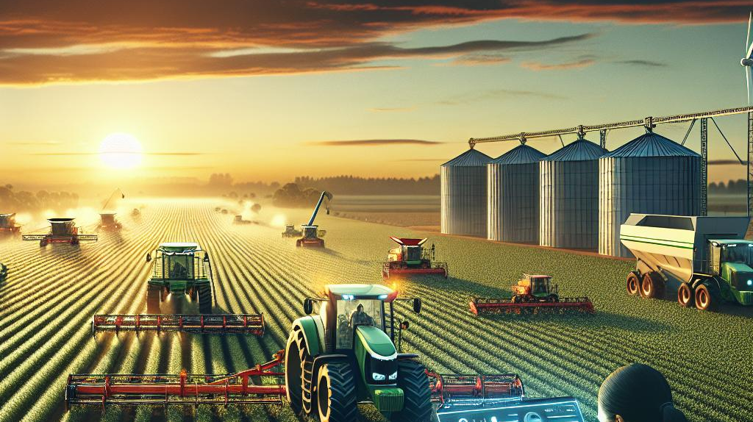
Unit 1 – Key idea
Digital tools reduce information gaps and support better decisions. Small farms can access real‑time weather forecasts, monitor crop health, and track yields. They can lower transaction costs and reduce information asymmetry, supporting climate‑smart practices and improved market access.
Notes:
Explain that digitalisation helps small farms make better decisions by reducing information gaps. Highlight weather, crop health and yield tracking. Keep it practical.

Slide 7
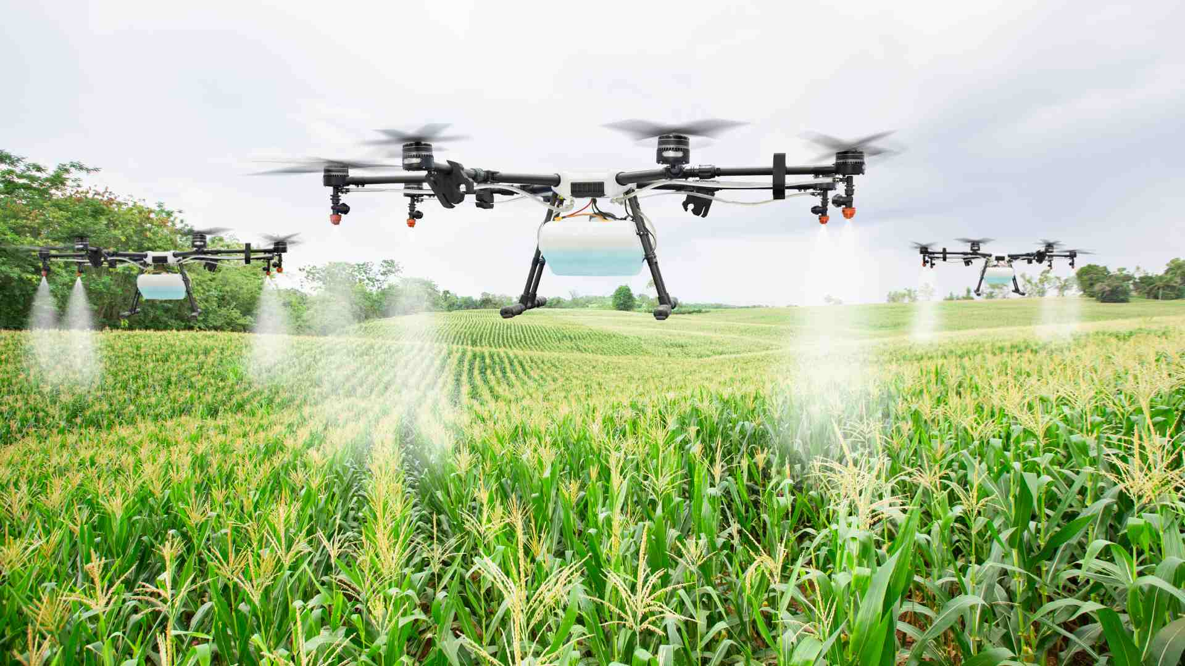
Unit 1 – Adoption context
Adoption depends on the “triple‑D” context:
• Digital literacy
• Digital access
• Decent internet
Choose tools that fit farmers’ realities and make training and support easier.
Notes:
Explain the triple‑D factors: digital literacy, access, and decent internet. Encourage learners to choose tools they can realistically use and sustain.

Slide 8
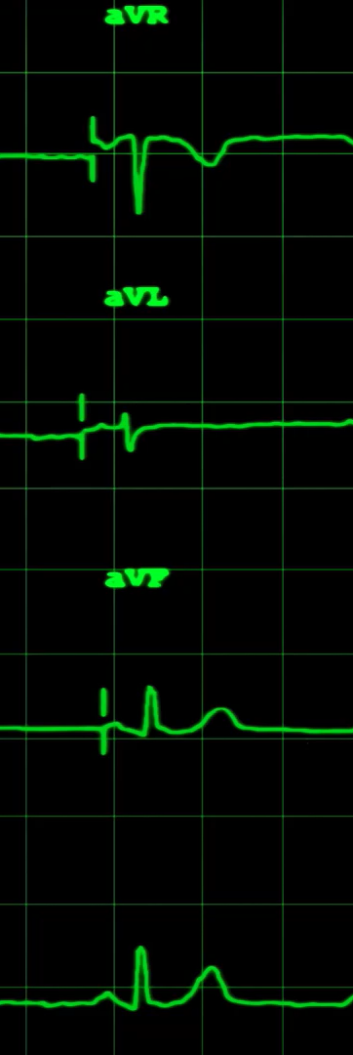
Unit 1 – Activity
Reflection activity:
List two digital tools you’ve heard of and how they might help a small farm.
Type your response in the text field.
Notes:
Model answers (from Word):
• Weather forecasting app: plan irrigation/harvest timing.
• Digital record‑keeping app/spreadsheet: track inputs/outputs and yields.
• Social media/marketplace platform: connect with buyers.

Slide 9
Unit 1 – Knowledge check
Which technology is an example of IoT in farming?
A) Spreadsheet to track expenses
B) Network of soil‑moisture sensors transmitting data
C) Radio announcement about pest outbreaks
D) Mechanical plough
“Big data” and “artificial intelligence” are used in agriculture to:
A) Increase farm taxes
B) Analyse large datasets for decision‑making
C) Replace farmers’ knowledge entirely
D) Repair irrigation pipes
Which category uses drones and satellite imagery to monitor crop health?
A) IoT
B) Remote sensing
C) Robotics
D) Blockchain
The “triple‑D” factors demonstrates:
A) Three types of digital devices
B) Digital literacy, digital access and decent internet
C) Digital pests, diseases and diagnostics
D) Digital diaries, detectors and drones
Blockchain technology can help small farmers by:
A) Providing high‑speed internet
B) Protecting fields against pests
C) Improving product traceability through a distributed ledger
D) Automating irrigation
Notes:
Answer: B

Slide 10
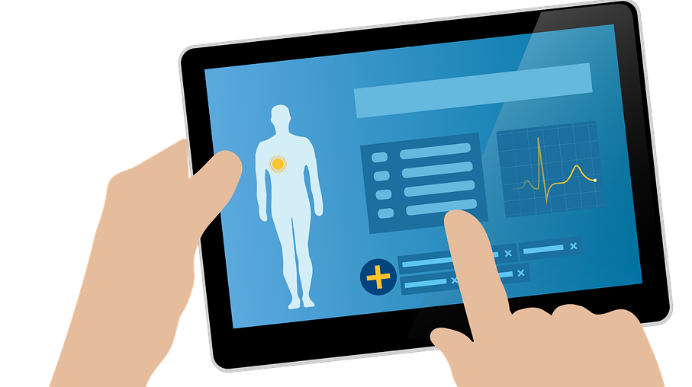
Unit 2: Digital Record‑Keeping for Farm Management
In this unit, learners see why accurate digital records improve farm management and learn typical features of record‑keeping tools (forms, dashboards, reminders and cloud storage), including the role of the “triple‑D” adoption factors.
Keeping accurate digital records (crop types, planting dates, yields, pest observations) helps you analyse trends, share information with advisors and make better decisions. A single dashboard stores and organises everything, reducing information asymmetry and lowering transaction costs.
Notes:
Set context: moving from paper notebooks to a dashboard that supports analysis and sharing.

Slide 11
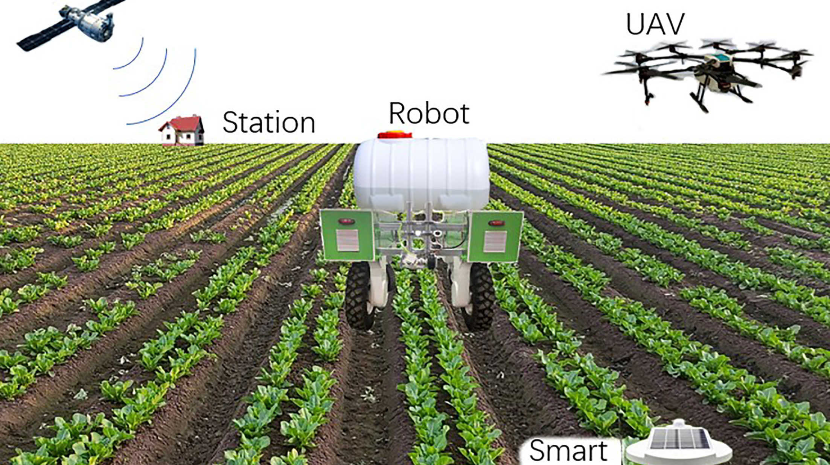
Unit 2 – Common features & adoption
This Photo by Unknown Author is licensed under CC BY
Modern tools typically offer:
• Forms for data entry
• Dashboards & reports (yields, input use, profits)
• Reminders/alerts (irrigation, harvesting)
• Cloud storage (backup + access)
Adoption depends on digital literacy, digital access and decent internet.
Notes:
Walk through the four common features. Remind learners about the triple‑D factors affecting adoption.

Slide 12
Unit 2 – Activity
Reflection activity:
Identify one benefit and one challenge of using digital record‑keeping tools for farm management.
Type your answer, then compare with the model answers.
Notes:
Model answers (from Word):
• Weather forecasting app: plan irrigation/harvest timing.
• Digital record‑keeping app/spreadsheet: track inputs/outputs and yields.
• Social media/marketplace platform: connect with buyers.

Slide 13
Unit 2 – Knowledge check
Which is a benefit of digital record‑keeping tools?
A) Increase paperwork
B) Lower transaction costs & improve decisions
C) Prevent crops from growing
D) Require no internet access
Which data fields are typical in a digital farm record?
A) Crop type, planting date, yield, pest observations
B) Weather forecast and radio frequencies
C) Music playlist and TV shows
D) Names of livestock only
The “triple‑D” adoption factors are:
A) Digital diaries, drones and databases
B) Digital literacy, digital access and decent internet
C) Drought, disease and debt
D) Digging, drilling and distributing
Why is cloud storage important?
A) Data is safe, backed up and accessible across devices
B) Prevents rain damaging notebooks
C) Removes need for devices
D) Automatically increases yields
Which could be a challenge when adopting these tools?
A) Too many notebooks
B) Lack of smartphones or stable internet
C) Too much free time
D) Low seed prices
Notes:
Answer: B

Slide 14
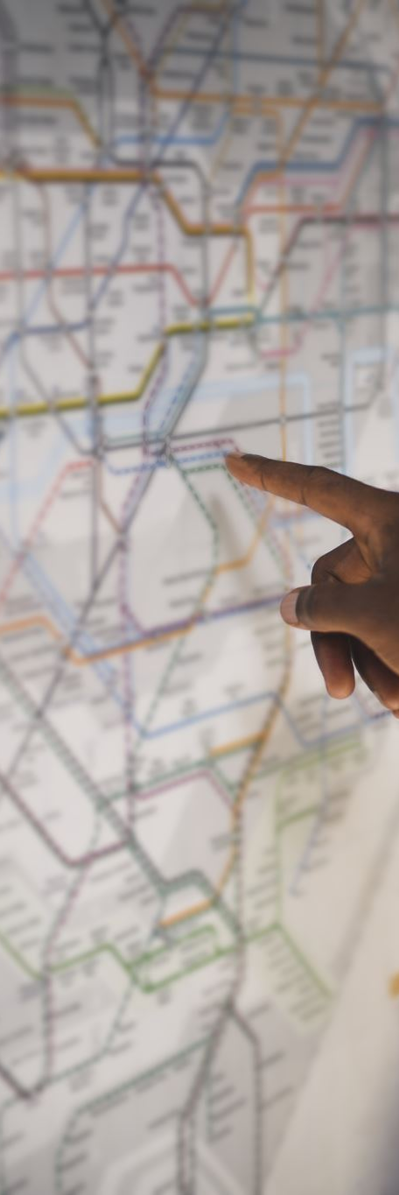
Unit 3: Remote Sensing & Geospatial Analysis (NDVI)
In this unit, learners understand remote sensing and the Normalized Difference Vegetation Index (NDVI), interpret NDVI values (–1 to +1), and use NDVI maps and public data services to identify crop stress and support field decisions.
Notes:
Introduce remote sensing and NDVI as practical tools for monitoring vegetation and spotting stress early.

Slide 15
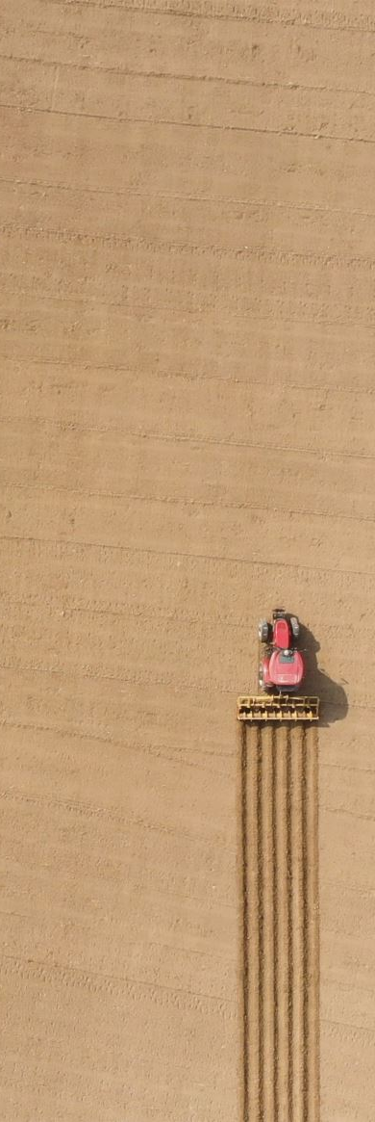
Unit 3 – Remote sensing
Remote sensing collects data about the Earth from a distance using sensors on satellites, drones or aircraft.
In agriculture, it lets farmers monitor crops over large areas without stepping into every field.
Notes:
Define remote sensing and link to monitoring without physical presence.

Slide 16
Unit 3
NDVI: what it measures
NDVI is a widely used index from remote sensing. It compares reflectance in the red and near‑infrared (NIR) bands. Healthy green plants reflect more NIR and absorb more red; stressed or sparse vegetation reflects less NIR.
NDVI: interpreting values
NDVI values range from –1 to +1. Negative values indicate water or clouds; values near 0 represent bare soil. Values around 0.1–0.5 indicate sparse vegetation, while values above 0.6 indicate dense green vegetation.
NDVI in practice
NDVI helps farmers:
• Detect crop stress (drought or disease)
• Monitor growth stages over time
• Estimate yields and biomass
• Prioritise field visits, target scouting and plan interventions
Notes:
Explain RED vs NIR reflectance and what healthy vegetation looks like.

Slide 17
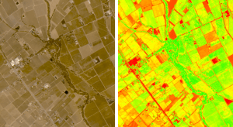
Unit 3 – Activity
Interactive image activity:
Observe an NDVI map and describe patterns. Identify low‑NDVI and high‑NDVI areas, suggest possible causes (e.g., drought or disease), and propose what you would check in the field.
Notes:
Use any NDVI image/map available. Prompt learners to hypothesise causes and decide what to check on-site.

Slide 18
Unit 3 – Knowledge check
NDVI is a measure of:
A) Crop yield
B) Plant health and vegetation density
C) Soil pH
D) Irrigation water pressure
Healthy green plants typically reflect more:
A) Red light
B) Near‑infrared (NIR) light
C) Ultraviolet light
D) X‑rays
NDVI values near 0 usually indicate:
A) Dense green vegetation
B) Bare soil or minimal vegetation
C) Severe drought
D) Heavy rainfall
Negative NDVI values often indicate:
A) Healthy crops
B) Water or clouds
C) Fertile soil
D) High yields
Remote sensing data can help farmers by:
A) Reducing the need for any field visits
B) Detecting stress early and prioritising scouting
C) Automatically planting seeds
D) Replacing irrigation systems
Notes:
Answer: B

Slide 19
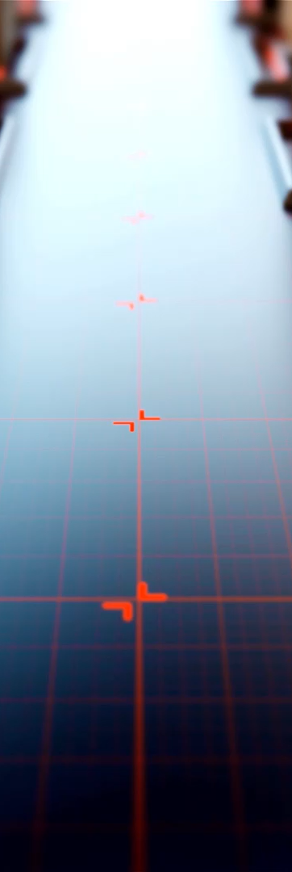
Unit 4: IoT Sensors & Smart Irrigation
In this unit, learners define IoT sensors in farming, see common devices (soil‑moisture probes, weather stations, temperature sensors), and use simple dashboard data to plan irrigation while considering cost, connectivity/power, and placement/maintenance.
IoT connects physical devices and sensors to the internet. On farms, sensors collect real‑time data (soil moisture, temperature, humidity, livestock health) and send it to a phone app or dashboard for monitoring and decisions.
Smart irrigation uses sensors and weather data to adjust irrigation schedules. By avoiding over‑watering and watering only when needed, farms can reduce water waste and support healthier crops. Some systems automate irrigation based on thresholds.
Notes:
Introduce IoT on farms and connect sensor data to irrigation decisions.

Slide 20
Unit 4 – Activity
Field | Moisture level | Temp
Field A | 28% | 22°C
Field B | 45% | 23°C
Reflection activity:
What are two considerations when installing IoT sensors on a small farm? (e.g., cost/scalability, connectivity/power, placement/maintenance).
Notes:
Model plan (from Word):
• Field A (28%) is below threshold → irrigate soon.
• Field B (45%) is above threshold → no irrigation now.
Adjust for upcoming weather, crop type and soil conditions.

Slide 21
Unit 4 – Knowledge check
IoT sensors help farmers by:
A) Collecting real‑time data about soil/crops
B) Replacing all irrigation pipes
C) Increasing paperwork
D) Preventing all pests
Soil‑moisture sensors can support:
A) Music streaming
B) Irrigation scheduling decisions
C) Seed packaging design
D) Tractor repairs
Which is an example of an IoT device on a farm?
A) Printed book
B) Weather station connected to a dashboard
C) Handwritten ledger
D) Plastic bucket
A key challenge for small farms adopting IoT is often:
A) Too much internet bandwidth
B) Device cost and connectivity
C) Too many dashboards
D) Excess rainfall
Smart irrigation aims to:
A) Use water only when needed
B) Water fields continuously
C) Remove need for monitoring
D) Increase transaction costs
Notes:
Answer: A

Slide 22
Unit 5: Artificial Intelligence & Data Analytics
In this unit, learners see how AI analyses farm data to support decisions on nutrients, fertiliser, crop rotation and early stress detection, and recognise limitations such as data quality and local infrastructure.
AI refers to computer systems that perform tasks requiring human intelligence. In agriculture, AI analyses data (sensor readings, weather patterns, soil samples) to optimise inputs, recommend actions and detect problems early.
AI can recommend fertiliser amounts, suggest crop‑rotation options, and analyse images to detect crop stress or disease early. These tools help farmers act sooner and use resources more efficiently.
Notes:
Position AI as decision support based on existing farm data, not a replacement for farmer expertise.

Slide 23
Unit 5 – Activity
Day | Date | Temperature (°C) | Rainfall (mm)
1 | 26 May 2025 | 28 | 0
2 | 27 May 2025 | 30 | 0
3 | 28 May 2025 | 29 | 12
4 | 29 May 2025 | 27 | 5
5 | 30 May 2025 | 31 | 0
Qualitative comparison:
Did you plan around rainfall? Did you adjust irrigation based on moisture needs? Did you consider the risk of fertiliser runoff during heavy rain?
Notes:
Model plan (from Word):
Day 1 (Feb 10): irrigate + apply fertiliser (dry conditions).
Day 2 (Feb 11): delay fertiliser; light irrigation if needed.
Day 3 (Feb 12): avoid fertiliser; reduce irrigation (high rain).
Day 4 (Feb 13): monitor soil moisture; fertilise only if soil is not saturated.
Day 5 (Feb 14): return to normal schedule if soil has drained.

Slide 24
Unit 5 – Knowledge check
AI in farming is used to:
A) Predict trends and optimise resources
B) Replace all human decisions
C) Eliminate need for sensors
D) Remove rainfall
A limitation of AI in agriculture is:
A) Too much sunlight
B) Lack of quality data and internet
C) Too many tractors
D) High soil fertility
AI can help by:
A) Analysing imagery to detect stress early
B) Painting crops green
C) Cancelling droughts
D) Creating more land
A benefit of AI‑powered analytics is:
A) Increased paperwork
B) Better decision‑making and efficiency
C) Reduced crop diversity
D) No need for planning
Farmers should use AI recommendations:
A) Without any local knowledge
B) Alongside their experience and local conditions
C) Only once per year
D) Only on paper notebooks
Notes:
Answer: A

Slide 25
Unit 6: Data Ethics, Cybersecurity & Sustainability
In this unit, learners understand GDPR and why data privacy matters in smart farming, apply basic cybersecurity practices (strong passwords, two‑factor authentication, updates and phishing awareness), and reflect on digital ethics and sustainability benefits of digitalisation.
Digital tools collect and store farm data. Data must be handled ethically and securely. In the EU, GDPR governs personal data processing and influences how apps and platforms collect, store and share data.
GDPR principles (overview):
• Transparency & purpose limitation
• Data minimisation
• Accuracy
• Storage limitation
• Integrity & confidentiality (security)
• Accountability
Cybersecurity basics for farmers:
• Use strong, unique passwords
• Enable two‑factor authentication
• Beware phishing links/messages
• Keep software updated
• Use secure networks (avoid public Wi‑Fi)
• Back up important data
Digital ethics means using data responsibly: share only what is needed, be transparent about data use, and avoid misuse. Digitalisation can support sustainability by improving input efficiency (water, fertiliser, energy) and enabling better monitoring and planning.
Notes:
Introduce remote sensing and NDVI as practical tools for monitoring vegetation and spotting stress early.

Slide 26
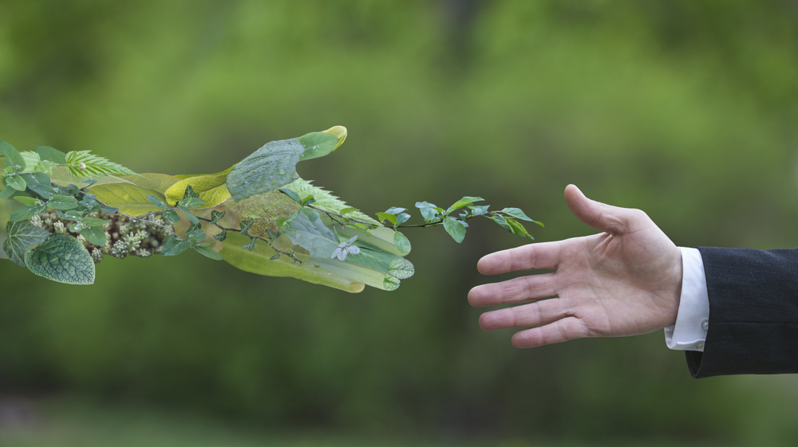
Unit 6 – Reflection
Reflection:
In 3–5 sentences, explain how digitalisation can contribute to sustainability on your farm.
Notes:
Example response (from Word): Digital tools help optimise water and fertiliser use by applying inputs only when needed, reducing waste and emissions. They improve monitoring and planning, support early detection of stress, and make farm operations more efficient and sustainable.

Slide 27
Unit 6 – Assessment
GDPR is primarily about:
A) Animal health
B) Data privacy and protection
C) Weather forecasting
D) Crop rotation
A strong cybersecurity practice is:
A) Use the same password everywhere
B) Two‑factor authentication
C) Share passwords with friends
D) Disable updates
Which is an example of unethical data use?
A) Sharing farm records with an advisor with permission
B) Selling farmers’ data without consent
C) Using data for irrigation planning
D) Backing up data securely
A sustainable benefit of digital farming tools is:
A) Increased water use
B) Better input efficiency and reduced waste
C) More paperwork
D) Less planning
One way to reduce phishing risk is to:
A) Click unknown links quickly
B) Verify messages and avoid suspicious links
C) Ignore updates
D) Post passwords online
Notes:
Correct answer: B
Explanation: GDPR sets rules for processing personal data in the EU and protects individuals’ privacy.

Slide 28

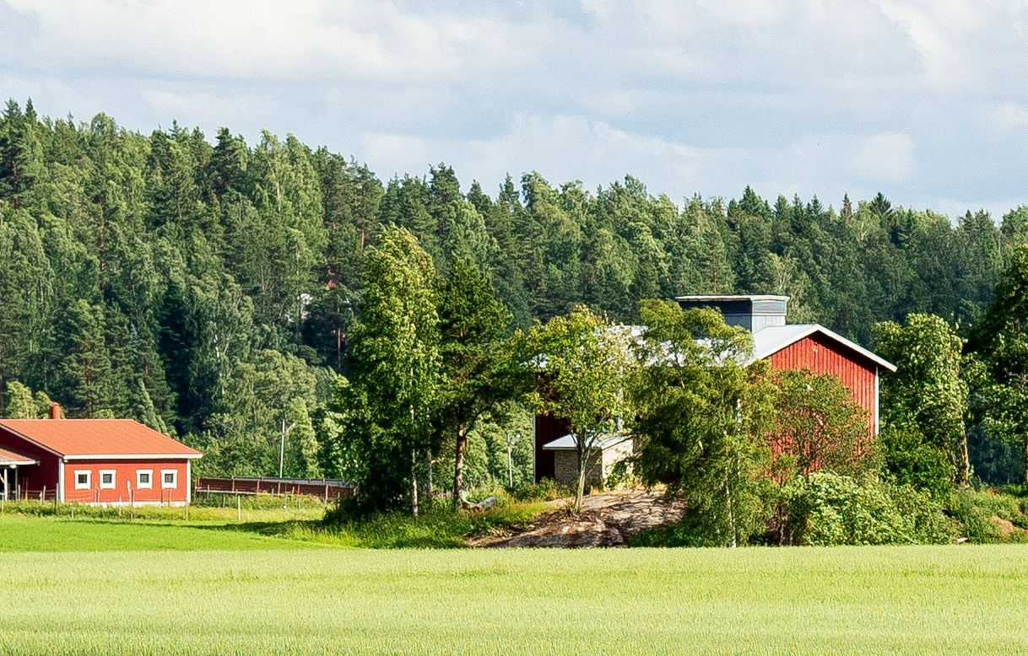
Module produced by: Magnetar
www.smart4food.eu

